Slide 1
TECHNICAL METHODOLOGY REPORT
DATA-DRIVEN INSIGHTS FOR NAMMA YATRI OPERATIONAL EXCELLENCE
Submitted By-
1.Shatrughan Patel
2.Surabhi Sharma
3.Shreya Aron

Slide 2
AGENDA
Objective:Uncover trends in ride behavior & demand
Data Prep: tables relationship, clean data, star schema
Feature Engineering: Calculated fields & metrics
Exploratory Analysis: Demand, revenue, zones, payments
Patterns: Temporal, spatial, behavioral insights
Recommendations: ETL pipelines, dashboards, predictive models
Conclusion: Key findings & strategic implications
Appendix/Q&A: Visuals, assumptions, leadership questions

Slide 3
OBJECTIVE & SCOPE
Objective:
We aim to uncover trends in trip behavior, spatial-temporal demand, payment preferences, Driver Peformance interms % cancellation and Revenue generating and also Customer behavior using structured analysis.
Scope:
Data model & preparation steps
Feature engineering (calculated fields, metrics)
Exploratory visual analysis
Performance & behavioral patterns
Recommendations with dashboards

Slide 4
KEY PERFORMANCE INDICATORS
Time-Based Driver Allocation
Peak ride requests occur during 8–10 AM and 6–9 PM
Reduce Customer Cancellations
Around 15–20% of quotes are not converted to rides due to cancellations by customers.
Optimize Ride Durations with Zone-Hour Matching
High delays in some zones during peak hours indicate poor driver distribution.
Encourage Drivers to improve their performance
By giving high incentives in late-nights and early mornings

Slide 5
DATA PREPARATION APPROACH
Tables Used:
-Trips (Fact Table)
-Duration, Assembly, Payment, Trip Details (Dimensions)
Relationship:
-tripid (primary key)
-duration_id, location_from, location_to, faremethod, payment_id
Preparation Steps:
-Cleaned headers and removed inconsistencies from merged cells
-Handled nulls: Removed rows with missing fare, driver ID, or trip status
-Filtered outliers: Trips with zero fare, distance = 0, or durations over 4 hours

Slide 6
FEATURE ENGINEEING METRIC
Calculated Fields:
Is_Cancelled: Identifies ride cancellations
Revenue per KM: Total fare divided by distance
Time_Bucket: Categorizes hours into 5 buckets (Early Morning, Morning, Afternoon, Evening, Night)
Metrics Created:
Ride completion %
Quote-to-completion rate
Payment method share
Tools Used:
Tableau calculated fields
Parameters to dynamically filter data based on time buckets

Slide 7
VARIABLE CLASSIFICATION
Categorical Variables: Duration, Payment Method, Assembly, etc.
Numerical Variables: Fare, Distance, Revenue per KM

Slide 8
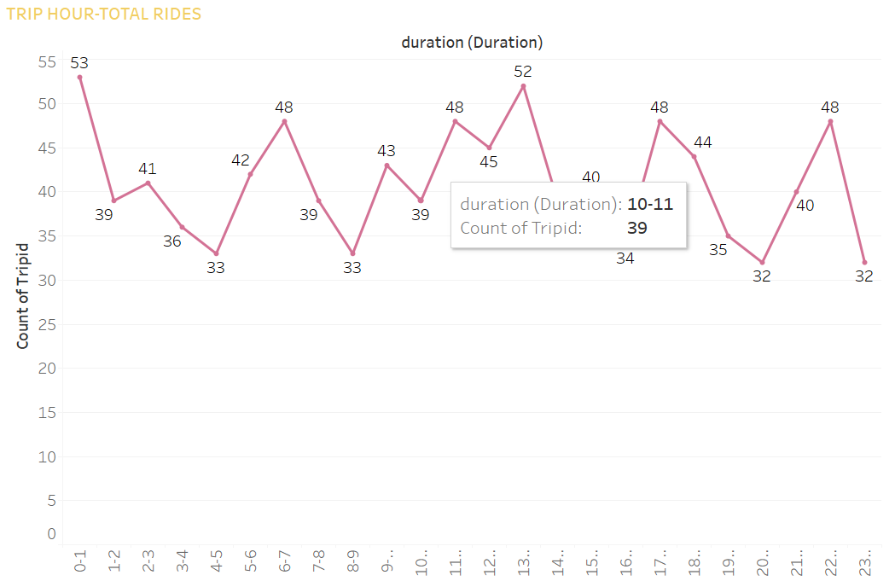
RIDE DEMAND OVER TIME

Slide 9
RIDE DEMAND OVER TIME
Insight
Peaks Observed at:
Early morning (6–7 AM), lunch (1–2 PM), and late evening (10–11 PM)
Very high demand post-midnight (0–1 AM)
Impact
Indicates early shift and late travel demand — useful for driver scheduling

Slide 10
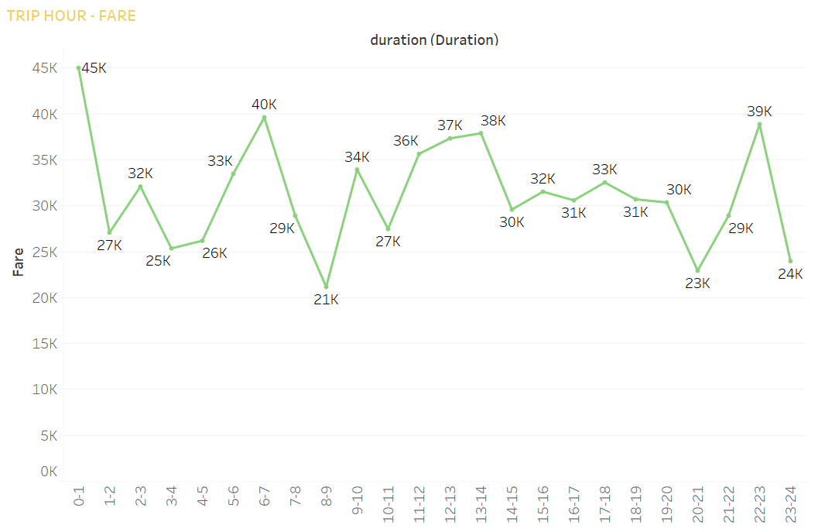
REVENUE OVER TIME

Slide 11
REVENUE OVER TIME
Insight:
High revenue generation overlaps with peak demand hours, especially:
0–1 AM (highest revenue)
6–7 AM
10–11 PM
Interpretation: These windows are likely driven by long-distance or high-value rides (e.g., airport runs or late-night surcharges). Optimization of fare strategies for these hours can further enhance profitability.

Slide 12
PICK-UP LOCATION VOLUME

Slide 13
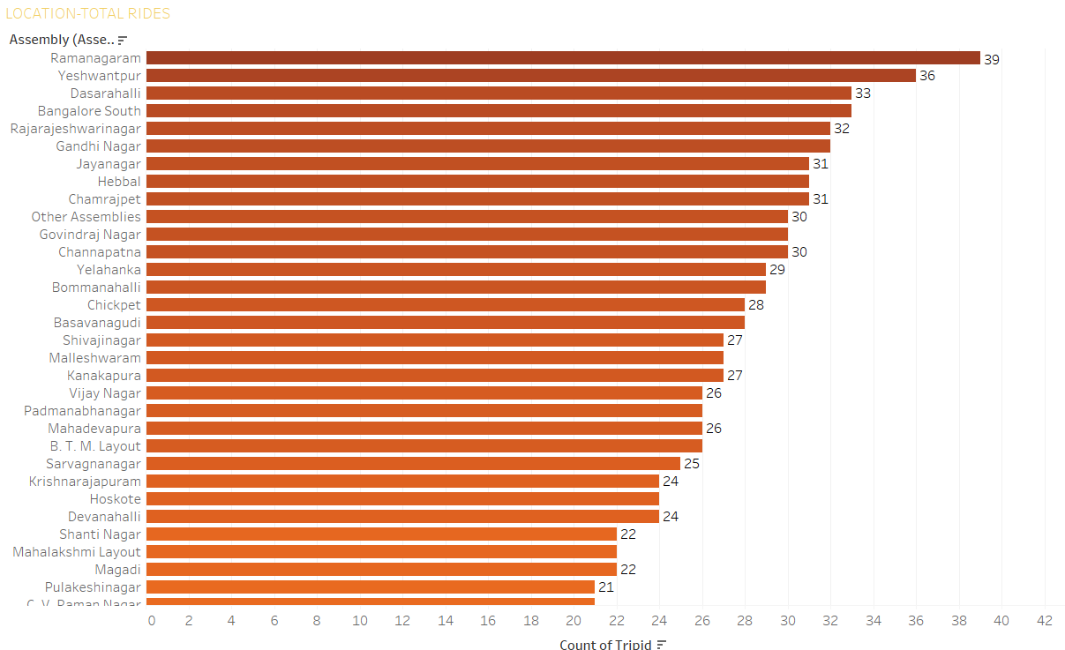
Pick-Up location Performance- No. Of Rides Basis

Slide 14
Pick-Up location Performance- No. Of Rides Basis
Metric | Pick-Up Location
Top-5 Performing Location based on Rides | 1.Ramanagaram
 | 2.Yeshwantpur
 | 3.Dasarhalli
 | 4.Banglore south
 | 5.Rajarajeshwarinagar
Top-5 Performing Location based on Revenue | 1.Bangalore South
 | 2.Yeshwantpur
 | 3.Hebbal
 | 4.Rajarajeshwarinagar
 | 5.Ramanagaram
Bangalore South leads both in trip count and revenue, suggesting a high-density, high-value zone. Targeting such zones with supply prioritization can help reduce wait times and increase fulfillment.

Slide 15
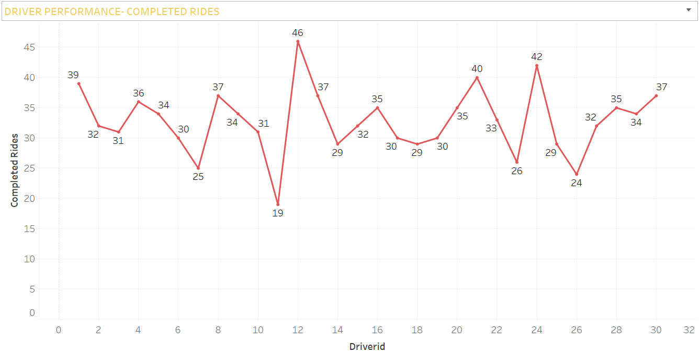
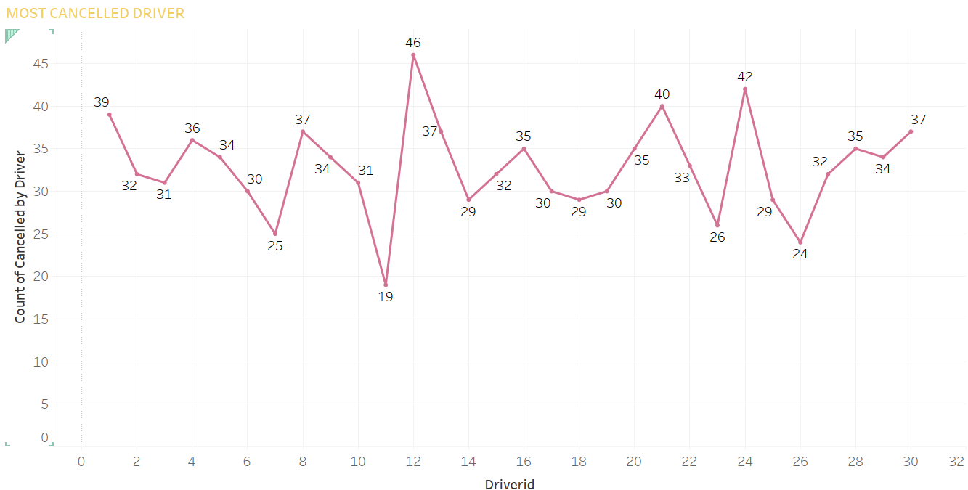
DRIVER PERFORMANCE:
Recommendation:
Set Clear Expectations
Define KPIs: On-time delivery, fuel efficiency, idle time, harsh braking/acceleration, route adherence, customer ratings, etc. and Communicate safety and service standards.
Monitor and Analyze Performance
Use Telematics: Install GPS and telematics systems to track speed, routes, fuel usage, braking, and acceleration.
Dashcams : To assess behavior and provide visual feedback.
Training and Development: Safe driving habits, Fuel-efficient driving and Customer service

Slide 16
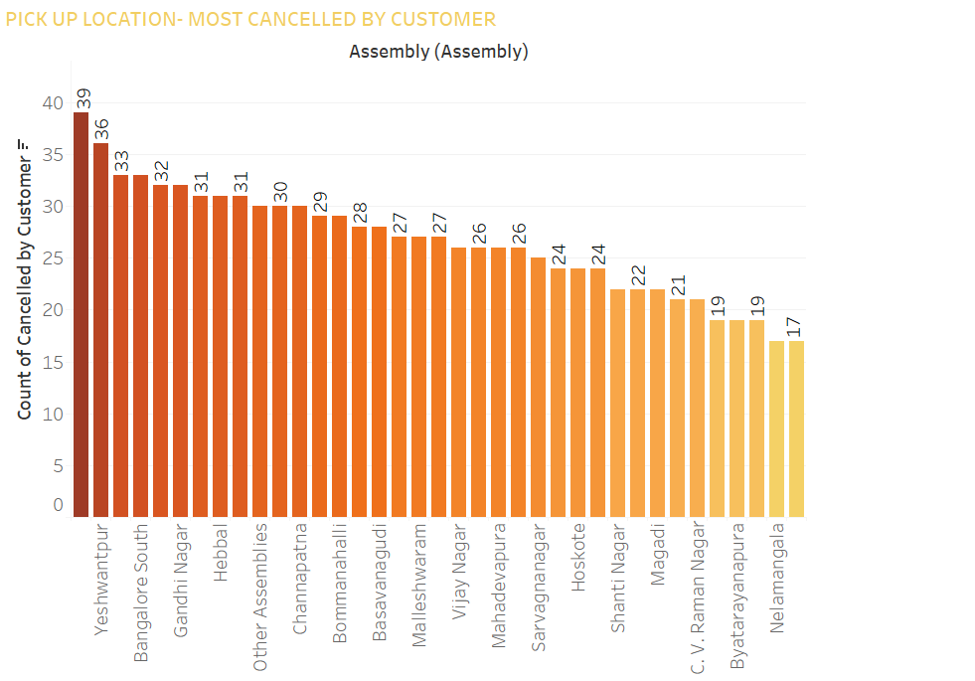
CUSTOMER BEHAVIOUR
Around 15–20% of quotes are not converted to rides due to cancellations by customers.
Recommendation:
Improve UX after quote received (clear price/time + quick confirm option)
Send follow-up notifications if a user doesn’t confirm

Slide 17
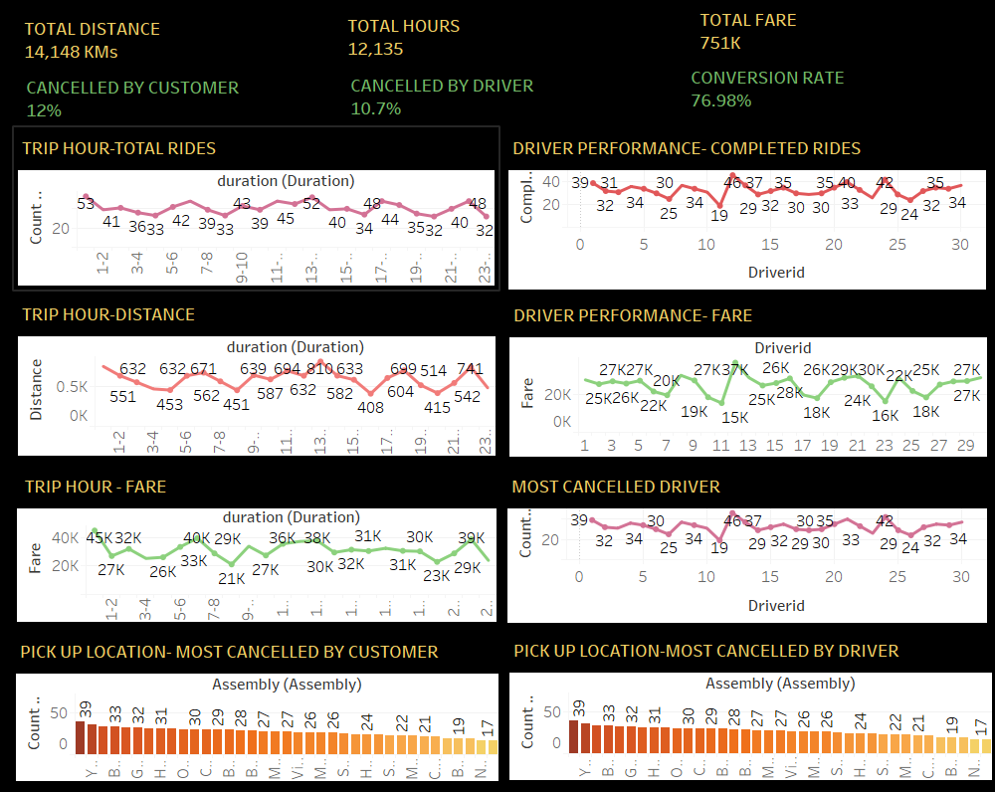
Dashboard:

Slide 18
Technical Recommendations:
Data Automation:
Build ETL pipelines for real-time ingestion and cleaning of trip data.
Dashboard Improvements: Integrate parameterized filters by zone, time, and payment for dynamic reporting.
Predictive Modeling: Use demand forecasting and zone-time combinations to drive surge pricing and driver deployment.
Anomaly Detection: Set alerts for spikes in cancellations or payment failures.

Slide 19
Thank You

